Slide 1
Ark breeding app
A website built by john oconnor

Slide 2
It has a home page!
The home page will be where you can log in and see all the tabs of the other pages
It will also explain the web site and what it is used for!
This website is an external source to maintain and organize your creatures from a video game called Ark Survival Evolved

Slide 3
It will have log in page!
This way each individual will have they're own account. Each account will have all its own creatures, tribe name, server name, and server stats
It will also stop people from going on to the site that are not going to use it for its intended purpose

Slide 4
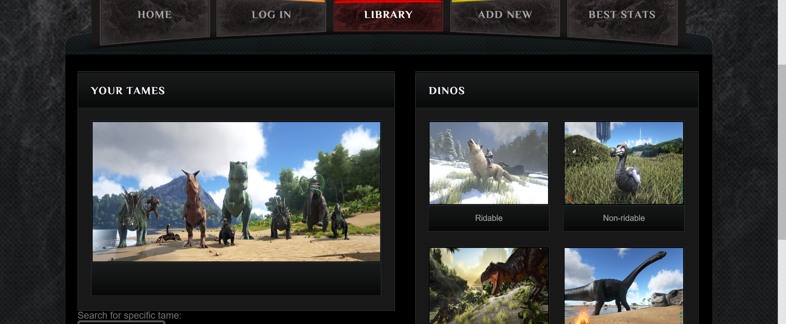
There is a library!
This is the place that you can see all the dinos you have captured or tamed in one organized list

Slide 5
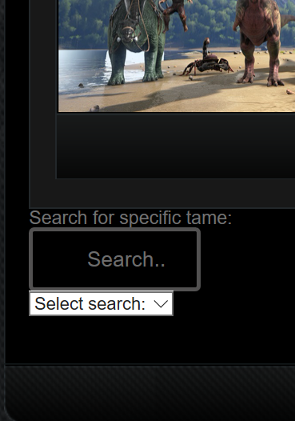
Have a lot of tames?
But don’t want to scroll though a huge list? That is why there is a search bar! So you can search for a name. species, level, male or female!

Slide 6
Have a new dino you want to add to the list?
Add it with the Add New Dino tab!
With this tab you can add a new dino and input all the stats and gender of the creature including the species, level, health, stamina ect…
This page will also organize all your tamed creatures in a list organized by either race, level, male or female

Slide 7
There is also a page to see just the best tamed creatures
The Best Stats tab on the webpage is just to see the highest level dinos or even if you want to see the best stat of a certain species
You can also organize how you see the creatures you are looking for by race, level, male and female

Slide 8
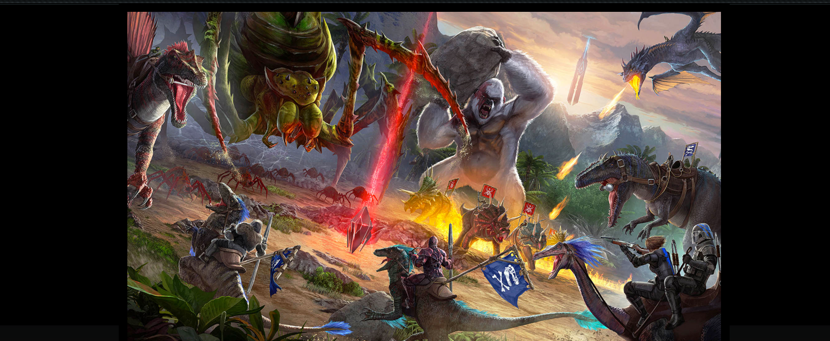
I hope you enjoyed learning about my website!

